Slide 1
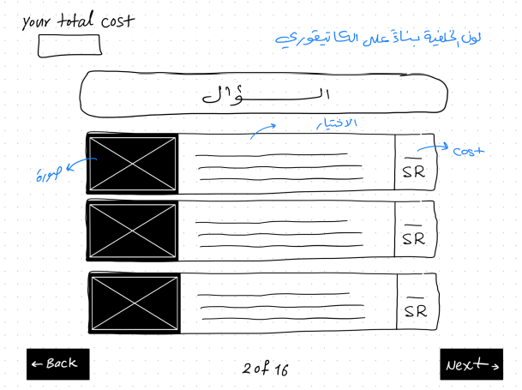
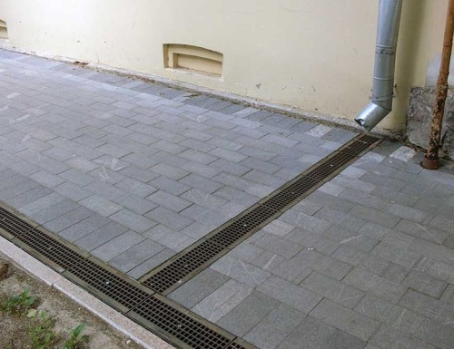
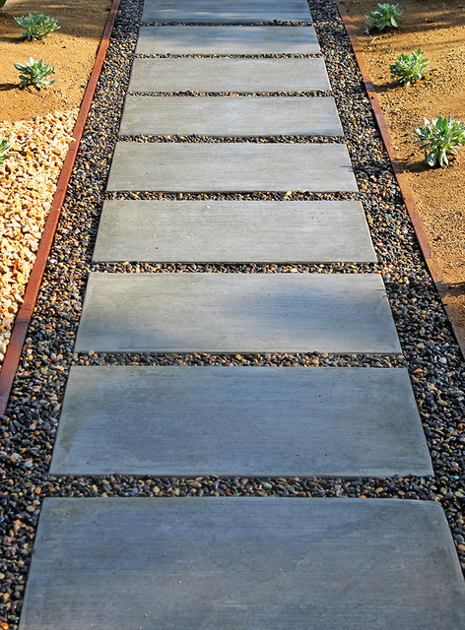
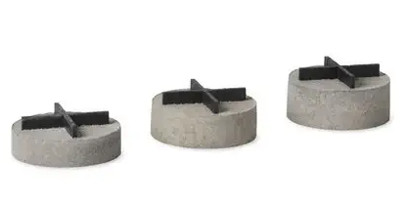
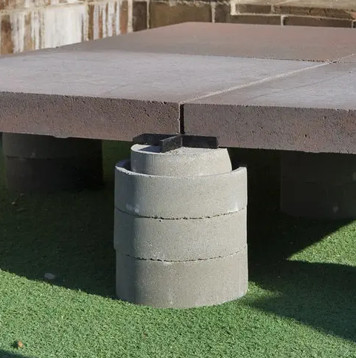
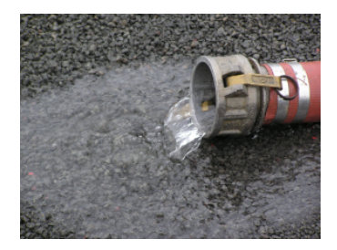
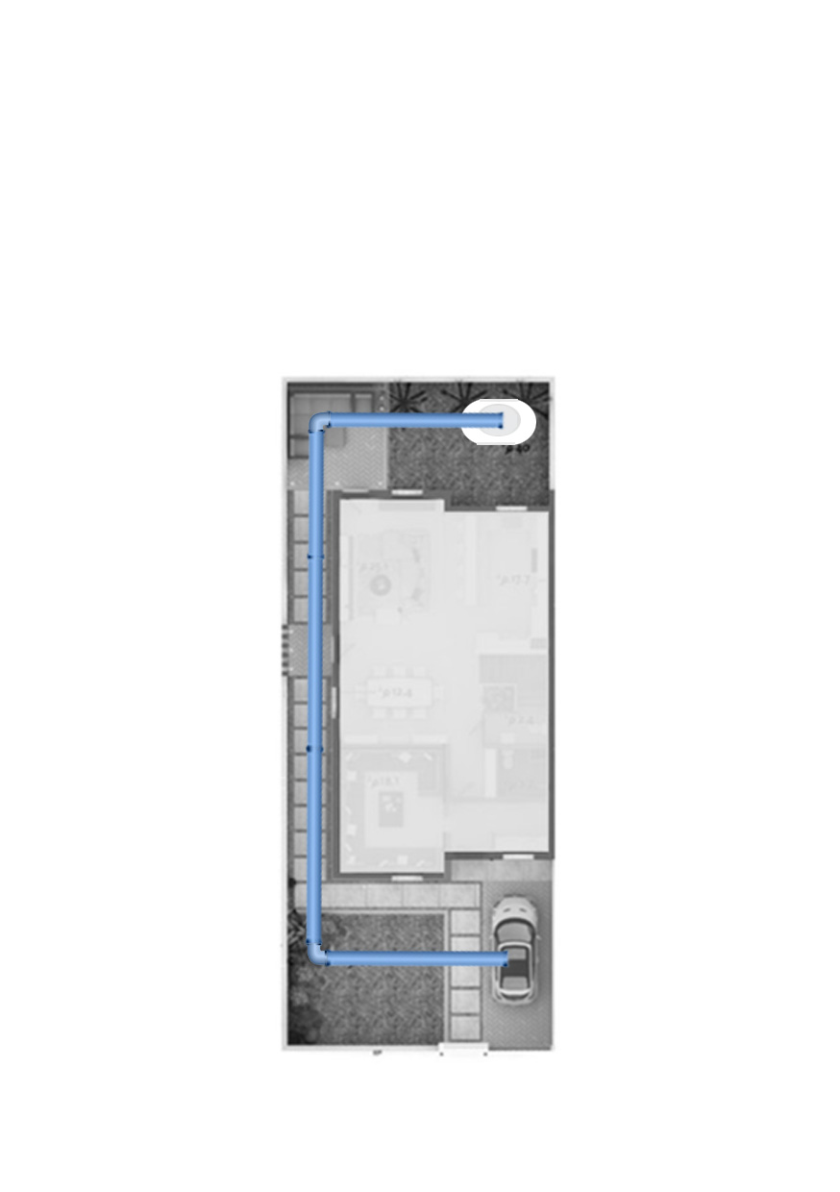
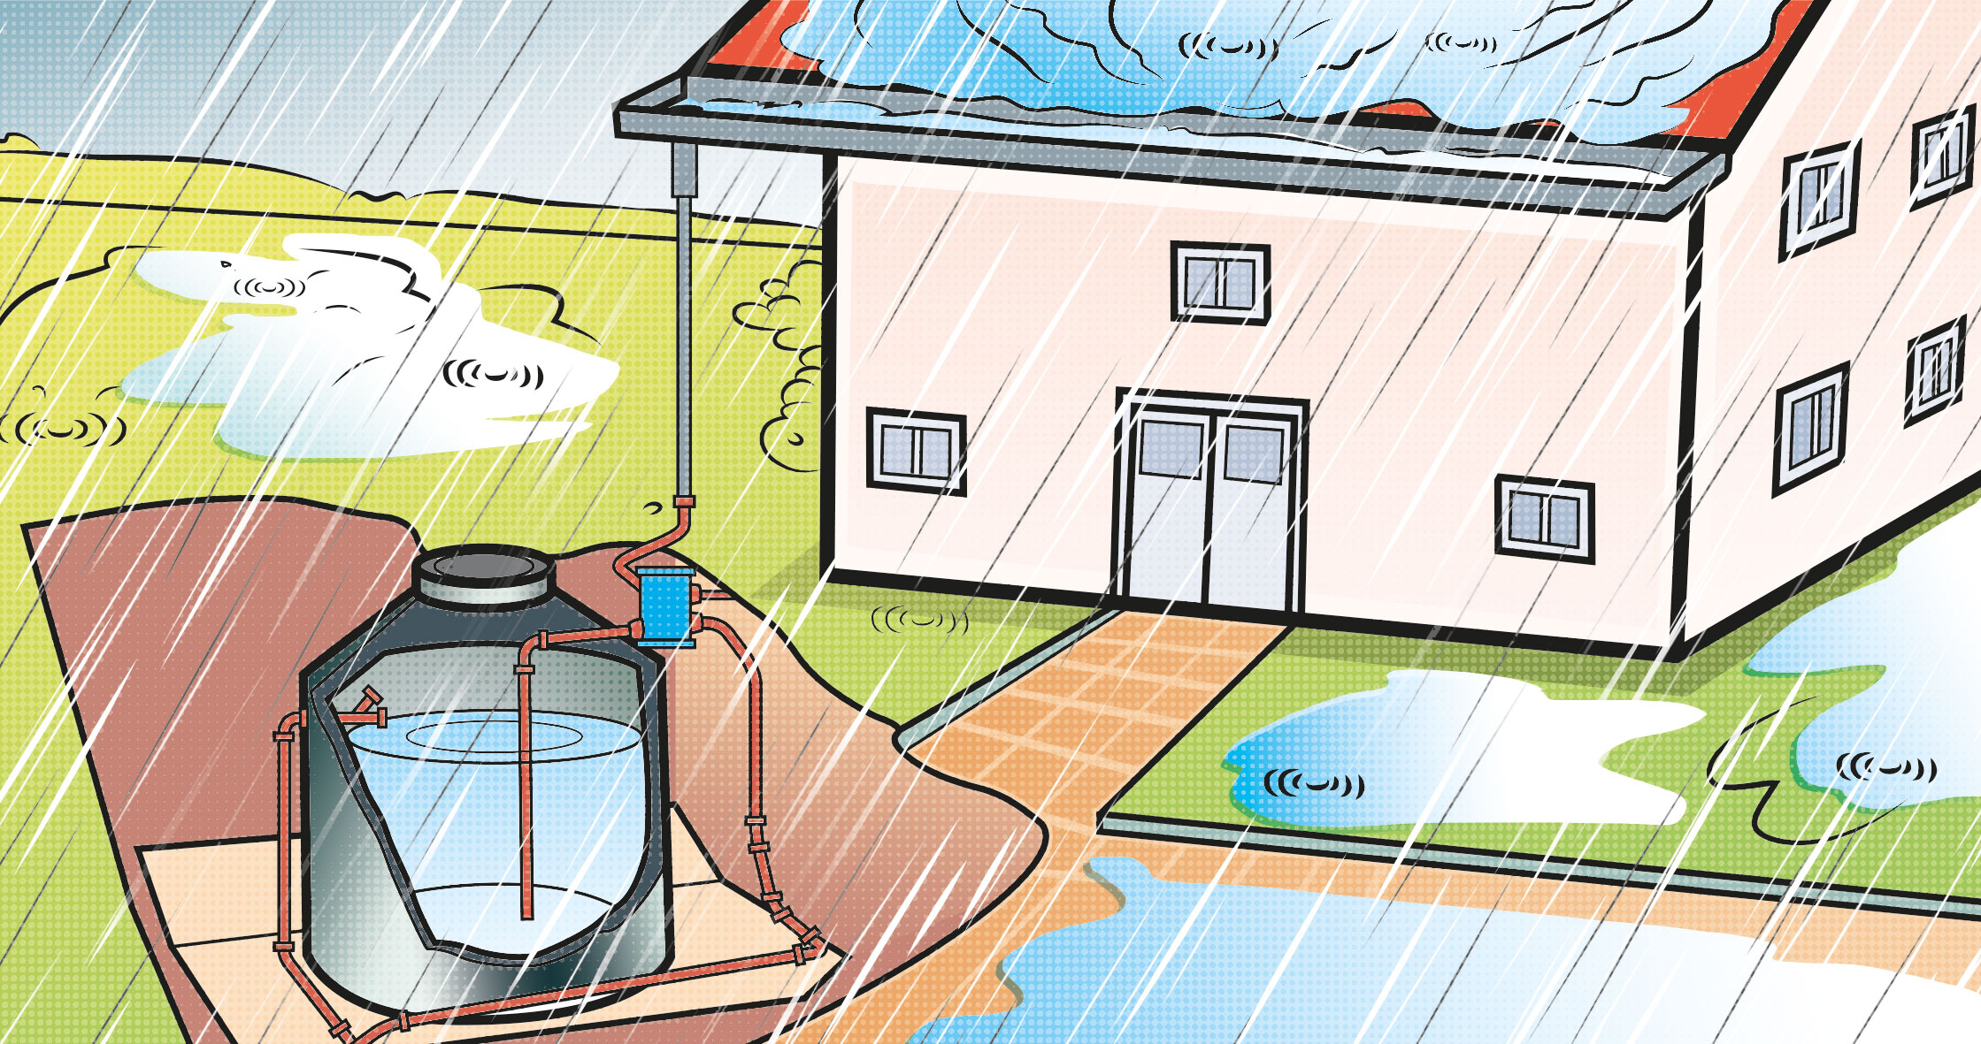
Site Sustainability
In the building you want to apply the rainwater management system by?
 | rainwater redirection strategy | 0 | 0.5
 | site infiltration paving with not connected tiles with gravel joints open-graded aggregate systems to the ground groundwater recharge | 6 | 0.5
 | open grid paving systems to storage tanks Use in building water supply system | 19000 | 0.5
Notes:
بس يقدر يختار وحده

Slide 2
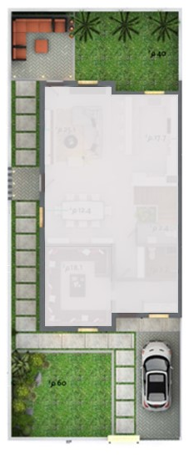
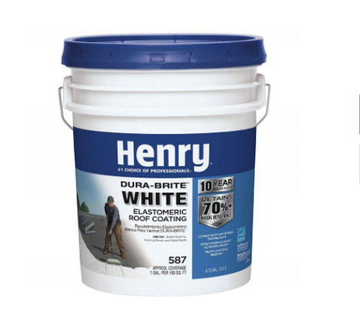
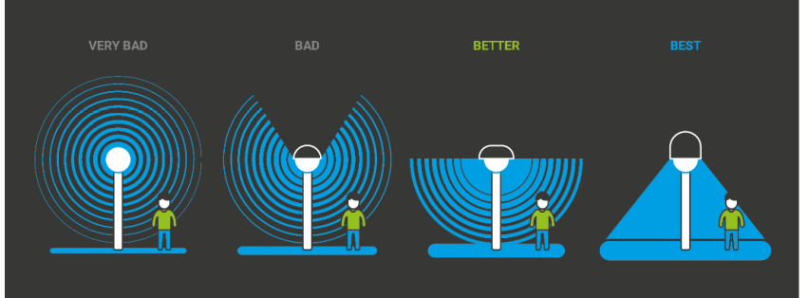
In the building you want to apply more features from Site Sustainability category chose one or more ?
 | A management strategy is created by a qualified Environmental Professional to ensure the survival and enhancement of the natural landscape | 26000 | 1
 | The three-year aged Solar Reflectance Index (SRI) values of the hardscape, shade structures and roofs meet the requirement | 5500 | 1
 | following the light and glare standards values in requirement | 1300 | 1
Notes:
يقدر يختار اكثر من وحدة

Slide 3
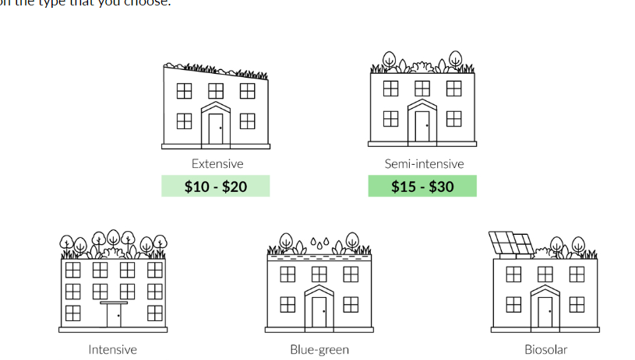
In the building you want to covering the unused roof area and/or structures used for shading by vegetative surface?
 | covering with an extensive green roof type | 6000 | 1
 | covering with a Bisolar roof green roof type | 13000 | 1
Notes:
وحده بس

Slide 4
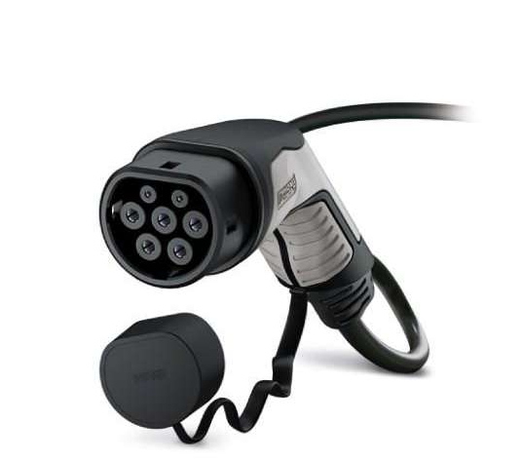
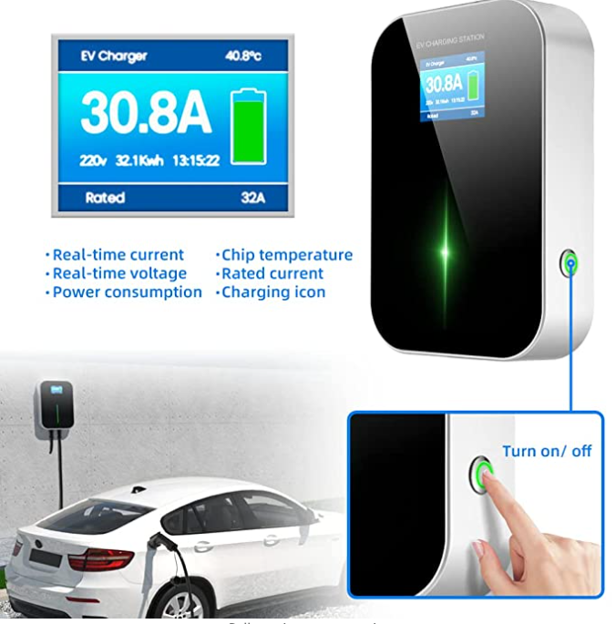
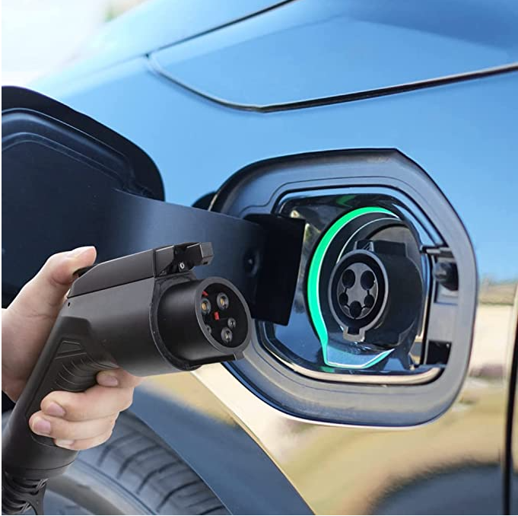
Transportation and Connectivity
In the building you want to install an electric vehicle supply equipment ?
 | Electric Vehicle Supply Equipment (Phoenix Contact) | 750000 | 1
 | Electric Vehicle Supply Equipment (BESENERGY EV) | 26000 | 1
Notes:
وحده بس

Slide 5
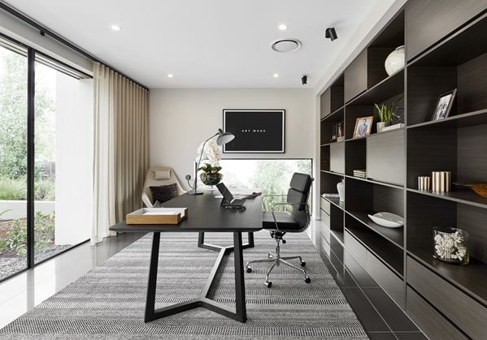
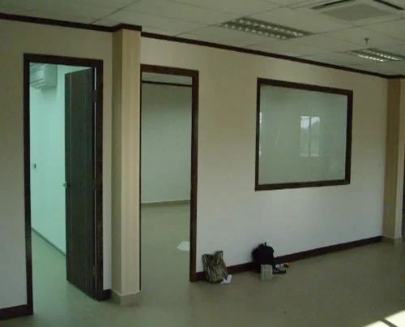
Transportation and Connectivity
In the building you want to have a separate home office/study ?
 | In case of replacing the use of one of the bedrooms to an office | 2000 | 1
 | An area of a room that has been separated by gypsum boards with an area of 15 square meters | 6000 | 1
Notes:
وحده

Slide 6
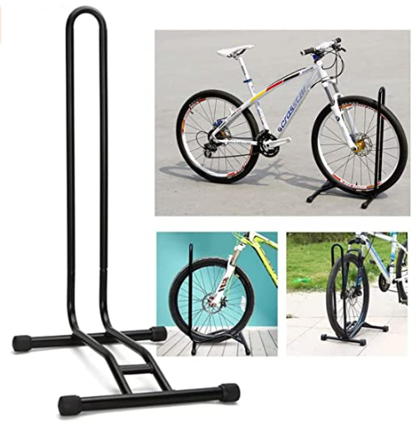
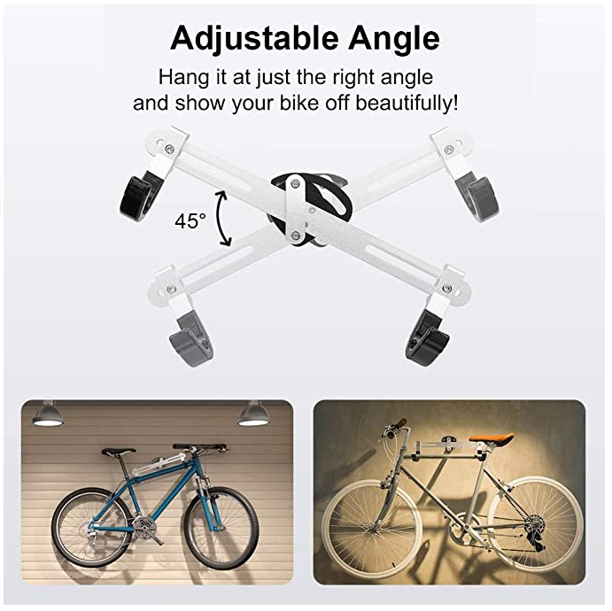
Transportation and Connectivity
Do you want to have a fully shaded parking area for a bicycle?
 | shaded bicycle parking floor stand type | 1600 | 0.5
 | shaded bicycle parking wall hanger type | 2000 | 0.5
Notes:
وحده بس

Slide 7
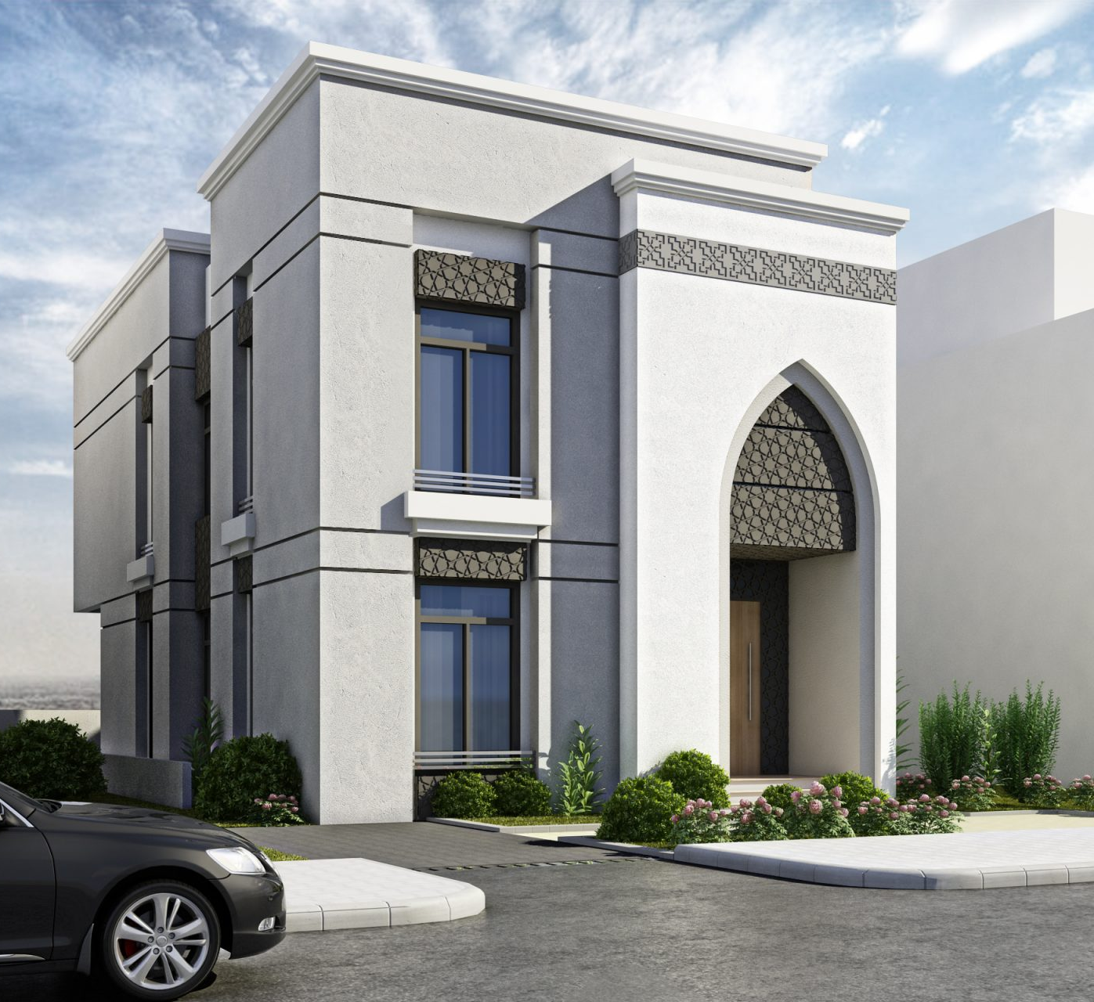
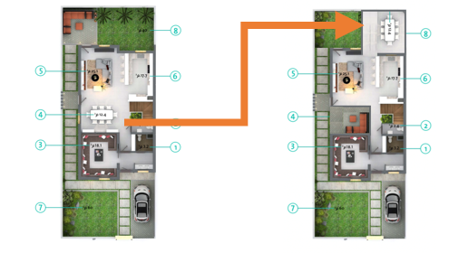
Region and Culture
Do you want to design the building harmoniously aligns with the local cultural and regional identities and traditions ?
 | Islamic geometric motifs on the building façade Architectural patterns | 20000 | 2
 | Interior courtyards naturally lit and shaded | 0 | 2
Notes:
يقدر يختار اكثر من وحدة

Slide 8
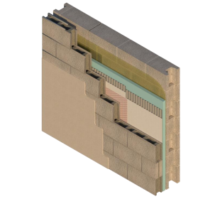
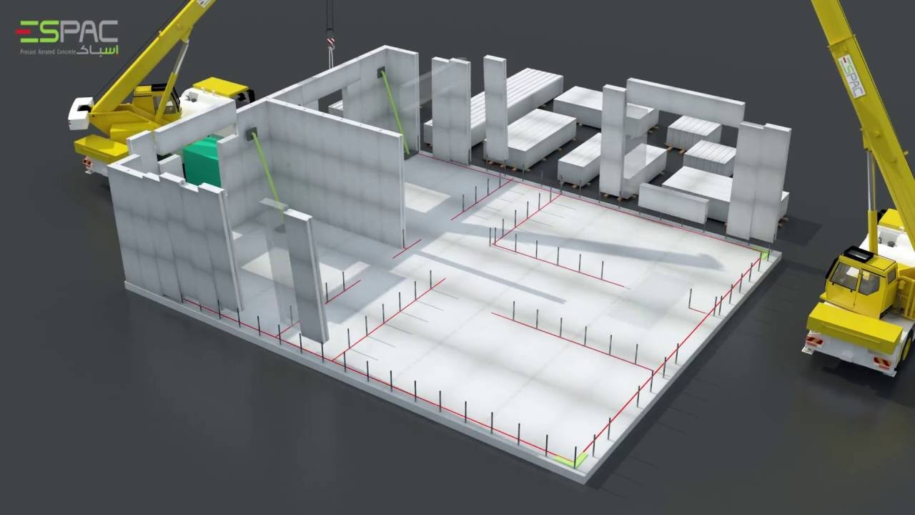
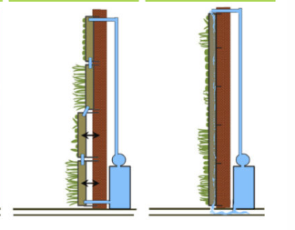
Energy
In the building do you want to applay features that reduce energy consumption?
 | Two wall system (improvement 6.78%) | 280000 | 1
 | lightweight aerated concrete AAC wall (improvement 5.88 %) | 5900 | 1
 | Exterior Green Vertical Landscaping Facades- Intensive Green Walls Types- (improvement 3.03 %) | 300 | 0.5
Notes:
وحده بس

Slide 9
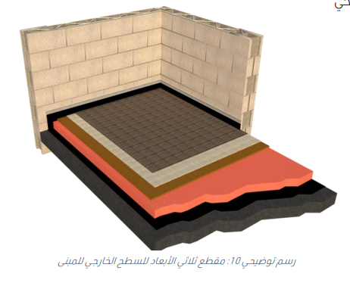
Energy
In the building do you want to applay features that reduce energy consumption?
 | High insulation roof layers (improvement 4.7%) | 5800 | 1
 | Cool Roof Use Highly Reflective Coatings on Roofs (improvement 2 %) | 46000 | 0.5
Notes:
متعدد

Slide 10
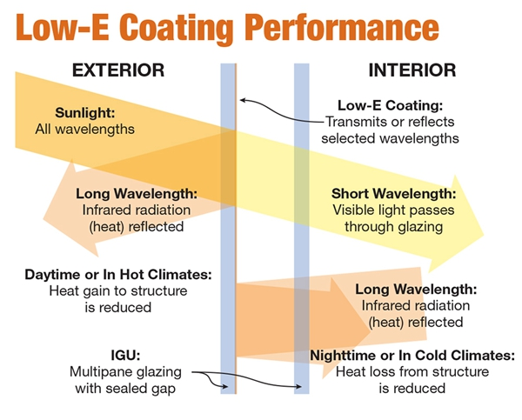
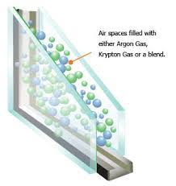
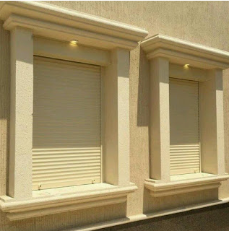
Energy
In the building do you want to applay features that reduce energy consumption?
 | Low-E glass coating Window (improvement 0.35%) | 7500 | 0.5
 | Argon gas filled windows in triple Pane Window with Low-E glass coating (improvement 1.25 %) | 10000 | 1
 | Electric shutter (improvement 0.53 %) | 1200 | 0.5
Notes:
وحدة بس

Slide 11
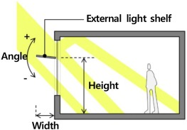
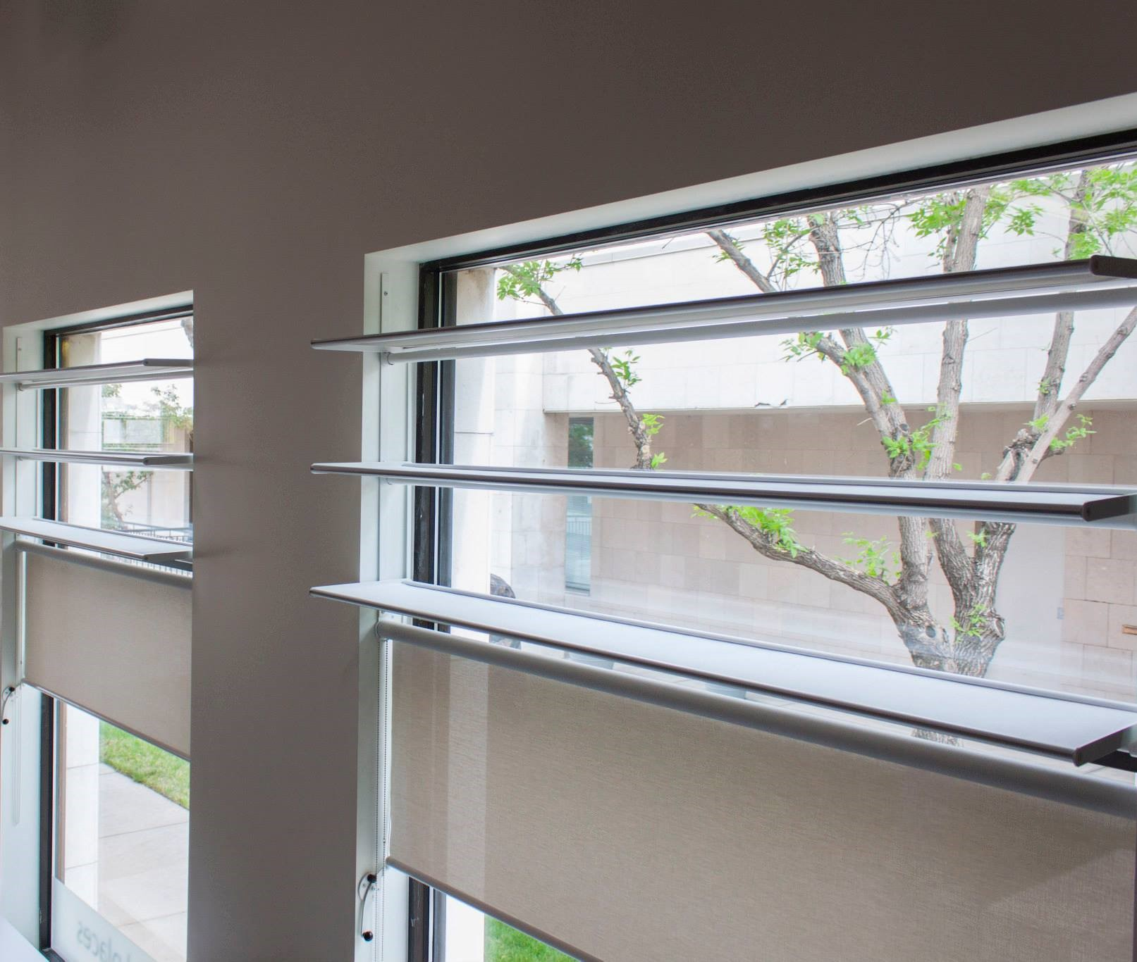
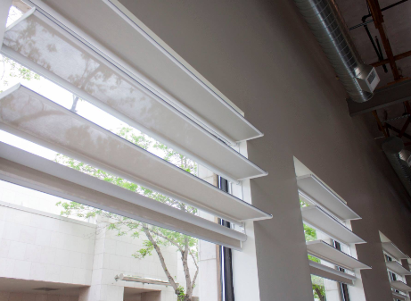
Energy
In the building do you want to applay features that reduce energy consumption?
 | One External Light Shelve (improvement 0.86%) | 10000 | 0.5
 | (improvement 0.74 %) the Daylight Light Shelve | 21000 | 0.5
Notes:
وحد بس

Slide 12
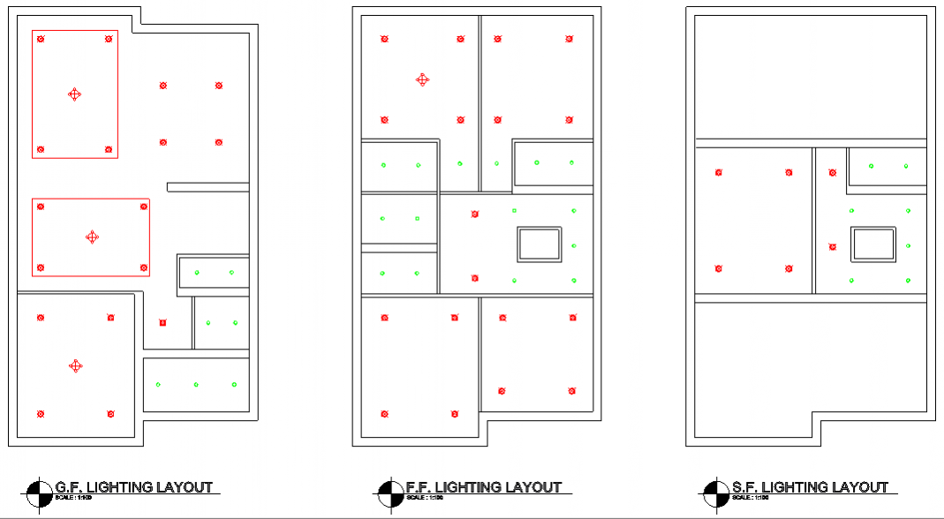
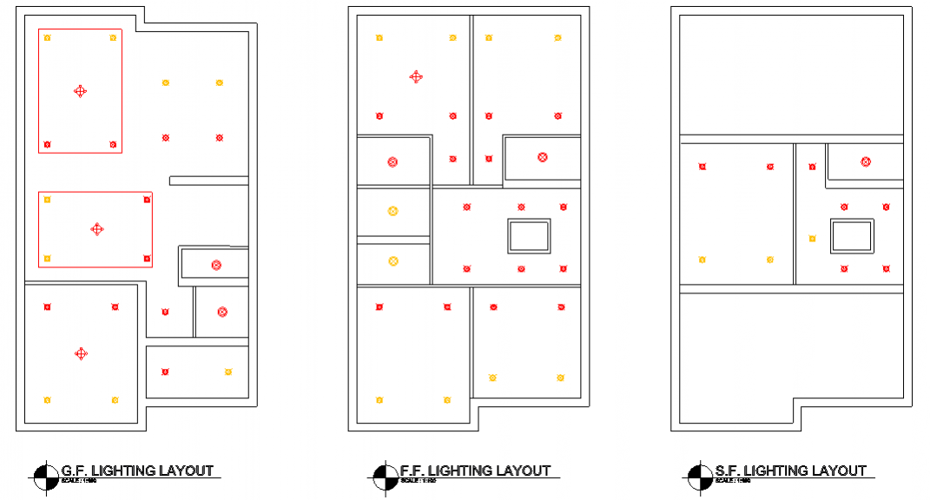
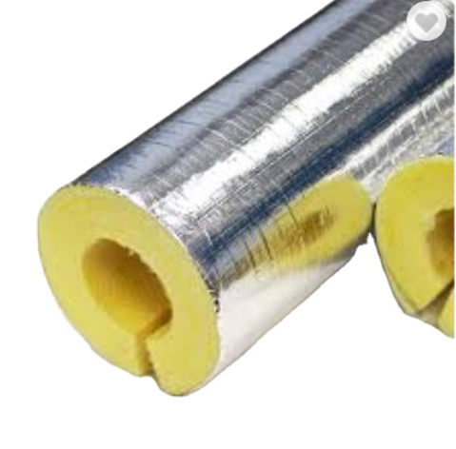
Energy
In the building do you want to applay features that reduce energy consumption?
 | adding a motion-sensitive lighting methods in (entrance, stairs, bathrooms, dressing rooms) (improvement 3.90%) | 4600 | 1
 | Arrange light switches according to window opening by distributed lighting fixtures to more than one switch in the sunlight level that entering room (improvement 0.85 %) | 26000 | 0.5
 | thermal insulation of all pipelines with fiberglass (improvement 0.5 %) | 200 | 0.5
Notes:
متعدد

Slide 13
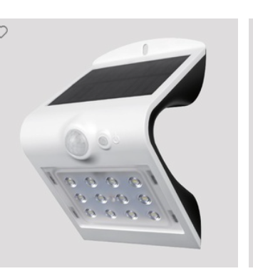
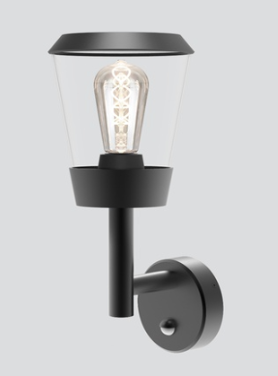
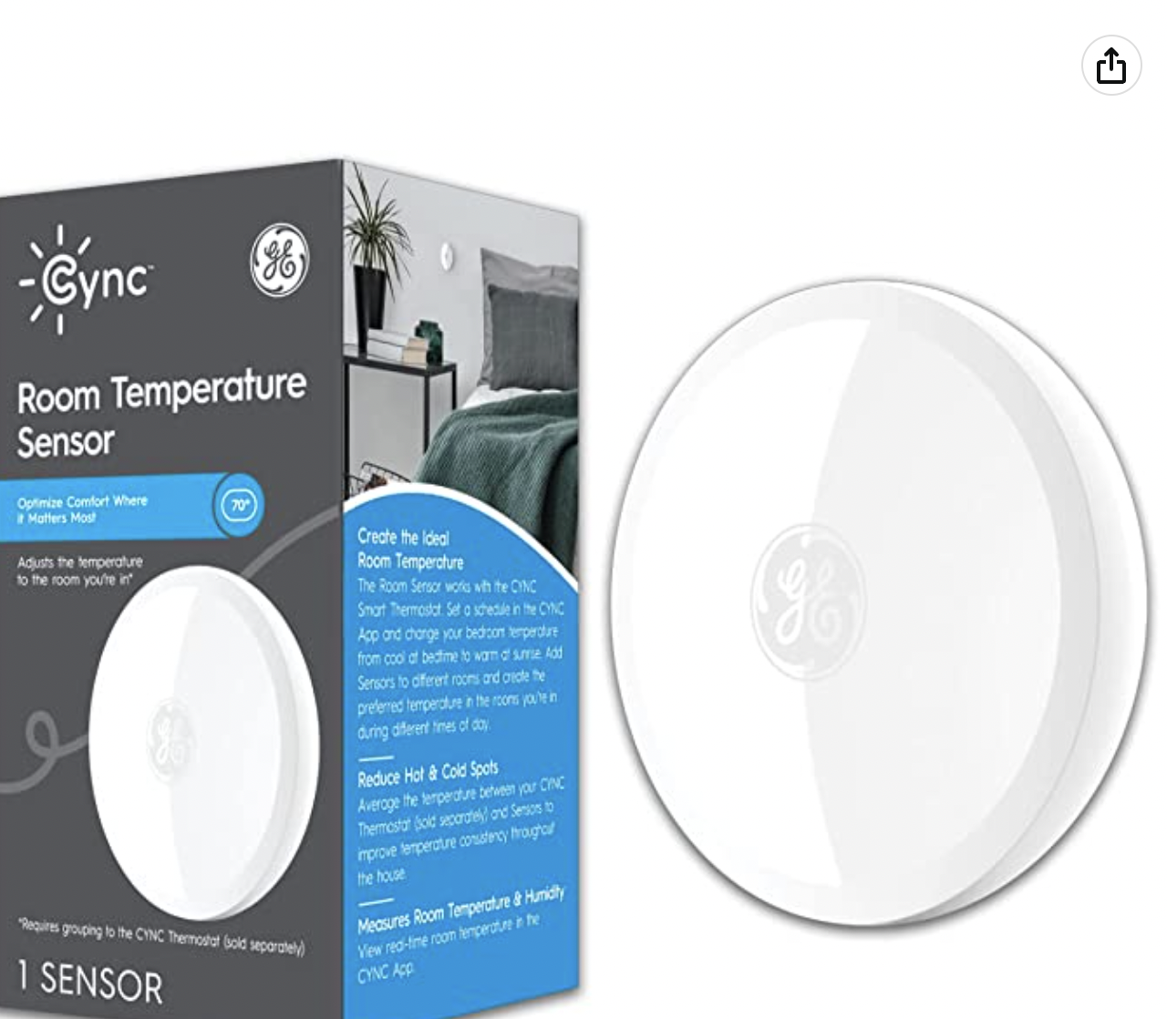
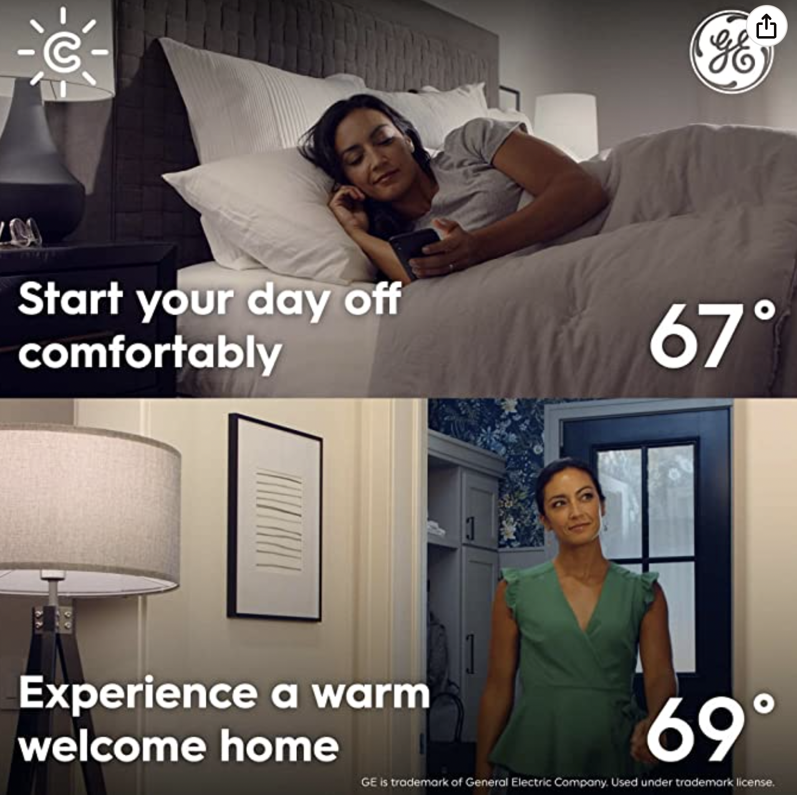
Energy
In the building do you want to applay features that reduce energy consumption?
 | Installing outdoor lighting units based on the solar energy (improvement 0.3 %) | 500 | 0.5
 | Installing outdoor Motion sensors lighting (improvement 0.27%) | 800 | 0.5
 | Using Technologies GE CYNC Smart Thermostat and Humidity Sensor (improvement 3%) | 18 | 0.5
Notes:
متعدد

Slide 14
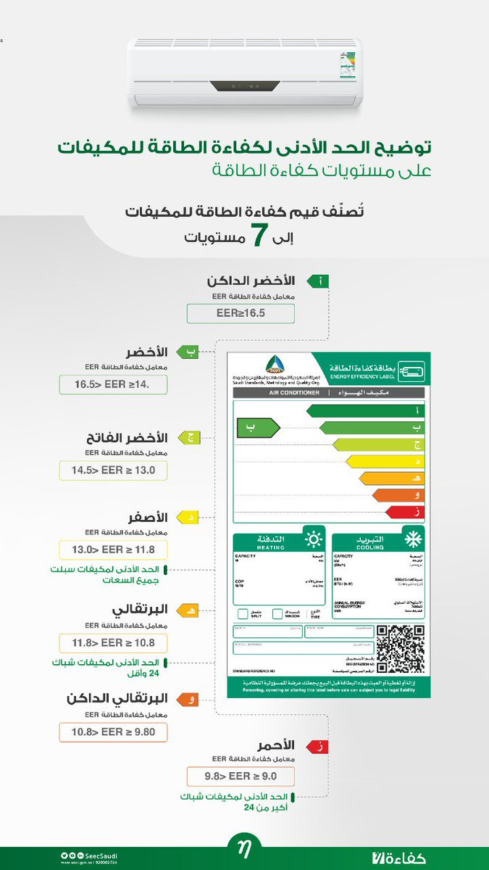
Energy
In the building do you want to applay features that reduce energy consumption?
 | Yellow )D( efficiency AC (13.0>EER>11.8) (improvement 12.90 %) | 9700 | 2
 | light green )B( efficiency AC (16.5>EER>14.5) (improvement 24%) | 38000 | 3
Notes:
واحد منهم

Slide 15
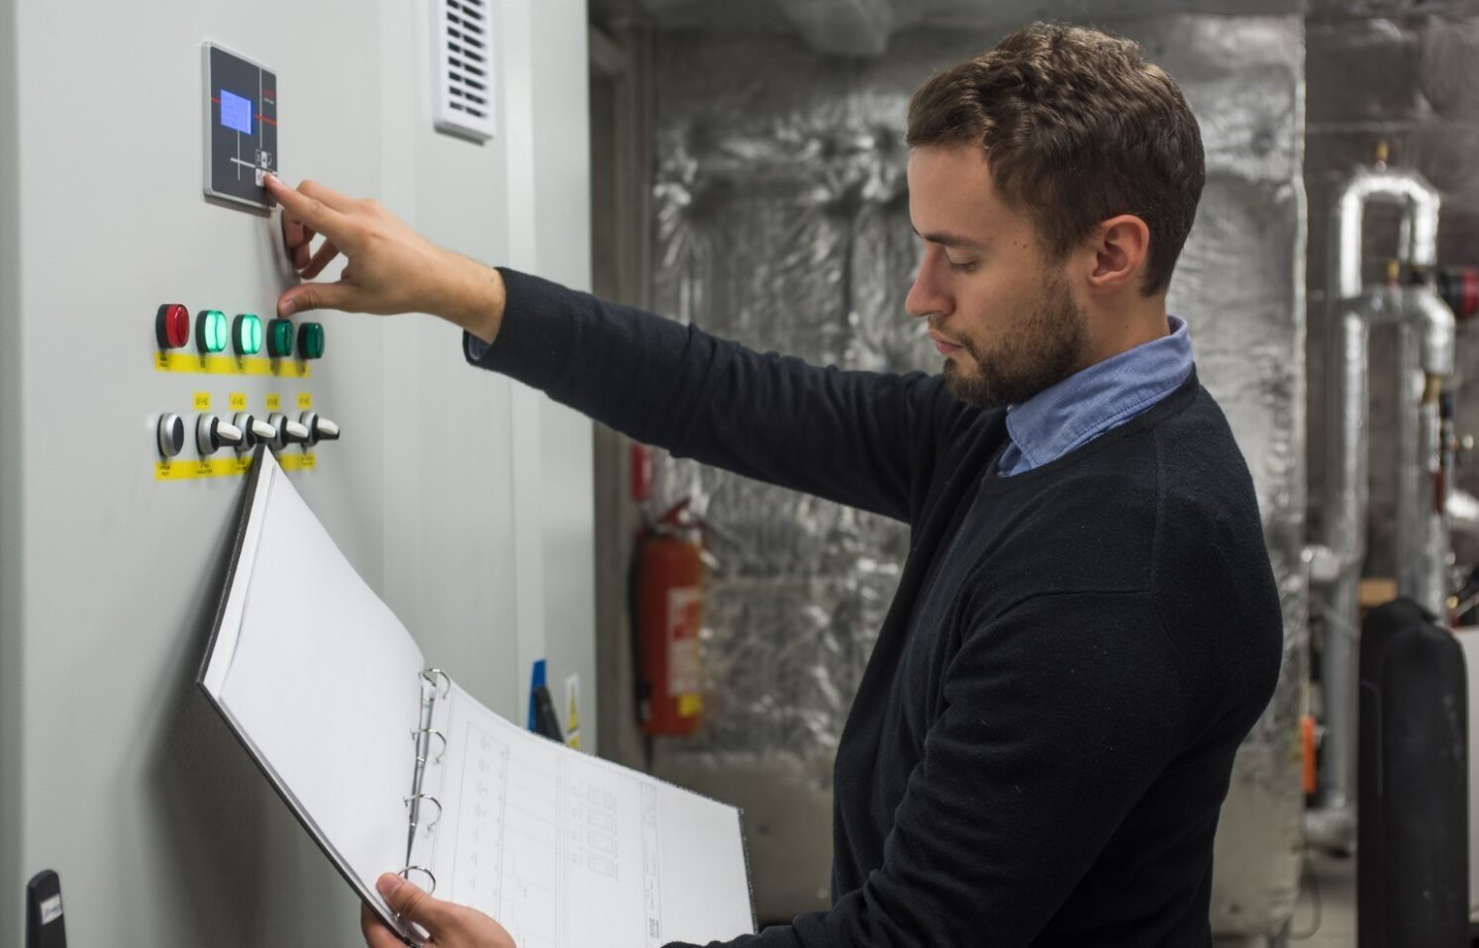
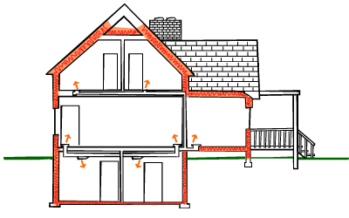
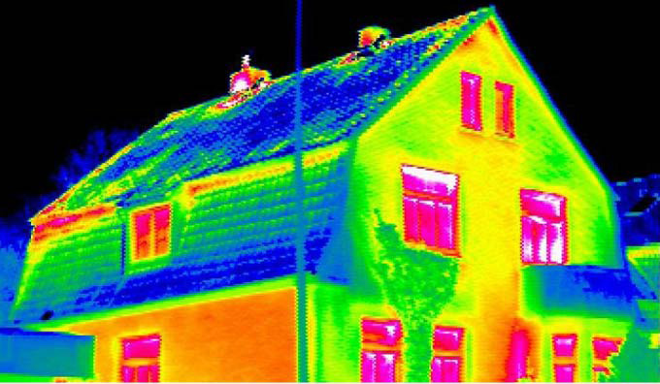
Energy
In the building you want to apply more features from Energy category chose one or more ?
 | Make sure that all systems and controls have been installed, and are operating, as intended by the commissioning certificates list of installed in the MOSTADAM Guide | 1300 | 1
 | A competent professional is retained to oversee basic building envelope verification | 2400 | 0.5
 | The building envelope is tested for condensation, water ingress, air infiltration and thermal bridging to ensure performance is as designed and in accordance with standards and has a pre-testing certificate. | 4500 | 0.5
Notes:
متعدد

Slide 16
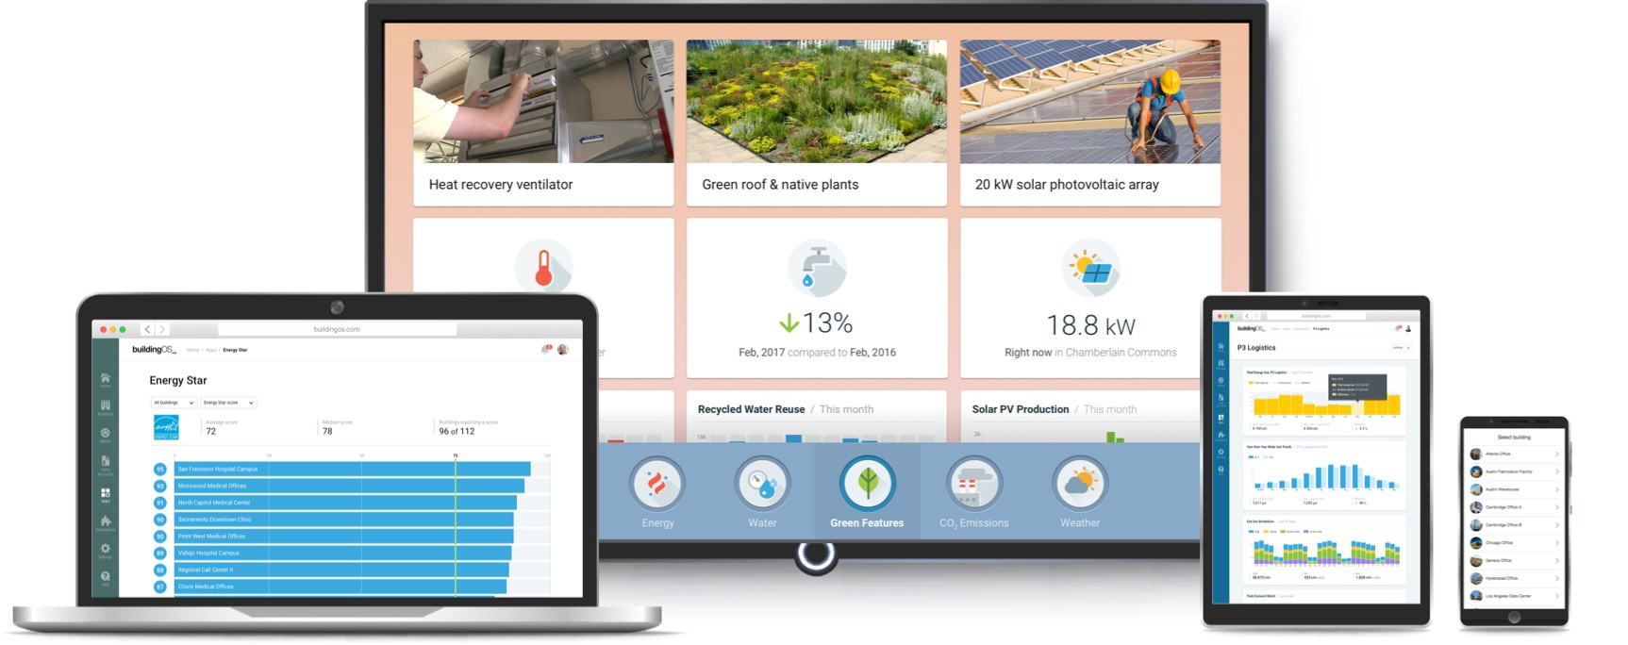

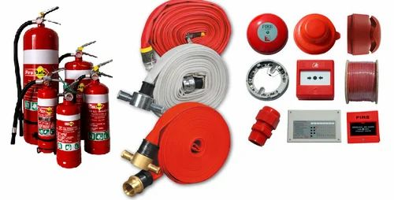
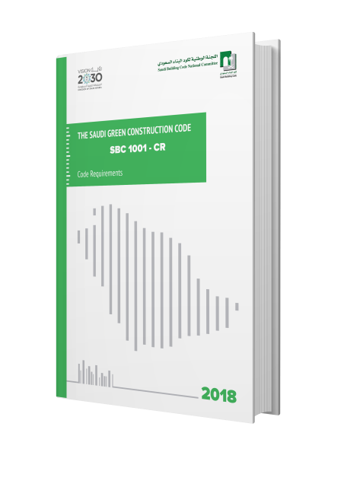
Energy
In the building you want to apply more features from Energy category chose one or more ?
 | A metering strategy is created and implemented which monitors the building’s energy usage and conforms to SBC 1001 Chapter 6. | 0 | 1
 | All relevant electrical appliances have an energy efficiency label from the Saudi standards | 6900 | 1
 | All refrigerants, fire suppression systems and maintenance gases installed and used within the project boundary have an ODP of zero. | 0 | 1
Notes:
متعدد

Slide 17
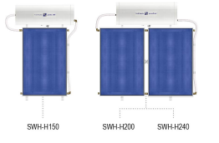
Energy
In the building do you want to have Solar hot water (SHW) panels that specified and installed to provide a minimum percentage of hot water demand?
 | Solar hot water panels provide 30% of hot water demand | 800 | 1
 | Solar hot water panels provide 50% of hot water | 1400 | 2
Notes:
وحده منهم

Slide 18
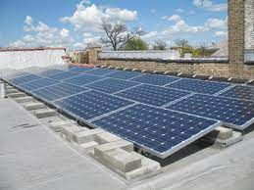
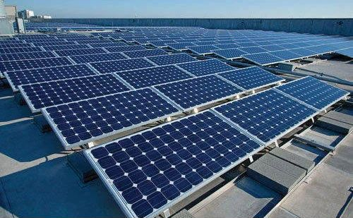
Energy
In the building do you want to generate electricity by photovoltaic (PV) that is installed onsite and provide a percentage of the total annual building energy demand?
 | PV panels achieve 4% of the renewable energy generated | 600 | 1
 | PV panels achieve 25% of the renewable energy generated | 3700 | 5
Notes:
واحد

Slide 19
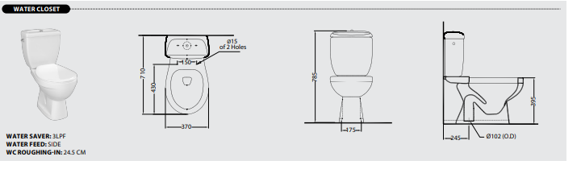
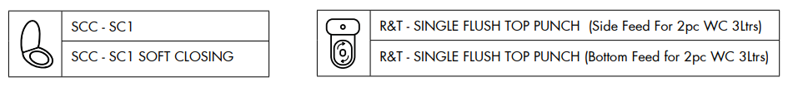






Water
Do you want to reduction the indoor water in the building compared to minimum performance levels ?
 | reduction 10% of indoor water consumption | 600 | 3
 | reduction 45% of indoor water consumption | 10000 | 10
Notes:
واحد

Slide 20



Water
Do you want to reduction the Outdoor water in the building compared to minimum performance levels ?
 | Reduces 50% by returning to landscape design professionals to plan irrigation areas and use automatic Micro Drip Irrigation System that connecting to the rain and surplus water collection tank | 2000 | 2
 | Reduces 80% by use Central Reverse Osmosis System Station as an irrigation Source | 23000 | 5
Notes:
واحد

Slide 21


Water
Do you want to make ‏the irrigation system controlled by smart controllers and / or soil moisture sensors to water reduces?
 | use soil moisture sensors in irrigation | 1500 | 2
 | use soil moisture sensors and smart controllers in irrigation | 1400 | 2
Notes:
واحد

Slide 22



In the building you want to apply more features from Water category chose one or more ?
 | There are no turfed areas within the project boundary | 18000 | 2
 | Air conditioning water condensate | 3600 | 1
Notes:
متعدد

Slide 23




In the building you want to apply more features from Water category chose one or more ?
 | Graywater recycling Graywater from showers, sinks, washing machines and dishwashers is collected and recycled to be used on-site for WC flushing or irrigation. | 48000 | 1
 | Treated wastewater At least 50% of wastewater is treated on-site and infiltrated or used on-site for irrigation. | 8600 | 1
Notes:
متعدد

Slide 24




Health and Comfort
In the building you want to apply more features from Health and Comfort
category chose one or more ?
 | Daylight and Artificial Lighting illuminance targets specified in the Supporting Guidance are achieved | 19000 | 1
 | have views and manual glare control are installed on all windows | 200 | 1
 | have views and automated glare-control devices are installed on all windows | 500 | 1
Notes:
متعدد

Slide 25


Health and Comfort
In the building you want to have a comfort zone of acoustics and indoor air quality?
 | field test reports obtained from the specialist audio engineer to make sure the Internal ambient noise levels are less than 35 to 40dB(A) | 200.00 | 1
 | Indoor Air Quality (IAQ) Testing | 3000.00 | 0.5
Notes:
متعدد

Slide 26


Health and Comfort
For building tightening the envelope the external doors for all building types are weather-stripped?
 | the external doors draft stopper under door seal (v shape) types | 300 | 0.5
 | the external doors draft stopper under door seal (PVC rubber) types | 100 | 0.5
Notes:
وحده

Slide 27





Health and Comfort
In the building you want to apply more features from Health and Comfort
category chose one or more ?
 | Front Entrance shading | 400 | 1
 | Courtyards/ patios shading cover | 2000 | 1
 | shading the walkways paths | 9600 | 1
Notes:
متعدد

Slide 28




Health and Comfort
In the building you want to apply more features from Health and Comfort
category chose one or more ?
 | Purchase orders for all (adhesives, Sealants, Paints and Coatings) do not exceed the VOC limits of (SCAQMD) | 2080.00 | 1
 | All internal composite wood materials and Suspended Ceiling Systems have maximum formaldehyde emissions as per the Supporting Guidance. | 1400 | 1
 | The design of the building complies with the requirements of the Lifetime Homes standard In to make building Access for All | 72500.88 | 1
Notes:
متعدد

Slide 29


Materials and Waste
In the bulding do you want to apply construction and demolition waste management plan (CDMP)?
 | Have a Contractor develops a construction and demolition waste management plan (CDWMP) | 7000.00 | 0.5
 | monthly monitoring of the CDWMP | 6000 | 0.5
Notes:
متعدد

Slide 30


Materials and Waste
In the building you want to have a features from Materials and Waste
category chose one or more ?
 | A minimum of 50% of all reinforcing or stressing steel used within the project boundary has a minimum of 80% post- consumer or pre-consumer recycled content. | 700.00 | 1
 | A minimum of 15% of all aggregates used on site are recycled aggregates. | 3200.00 | 1
Notes:
متعدد

Slide 31


Education and Innovation
In the bulding do you want to adopte an innovative design or construction solution that improves the durability or flexibility of the building or reduces maintenance requirements?
 | An innovative design or environmentally friendly product | 4600 | 2
 | sustainable innovation in the building structure or in the hydraulic or smart systems | 58000 | 2
Notes:
واخد

Slide 32




Policies, Management and Maintenance
In the building you want to have a features from Policies, Management and Maintenance category chose one or more ?
 | Residential Waste Management by Recycling bins | 600.00 | 0.5
 | Residential Waste Management by Recycling waste sorting bag | 22.00 | 0.5
 | Smart meters and digital feedback systems are installed which configure and display energy and water usage data | 0 | 0
Notes:
متعدد

